Slide 1
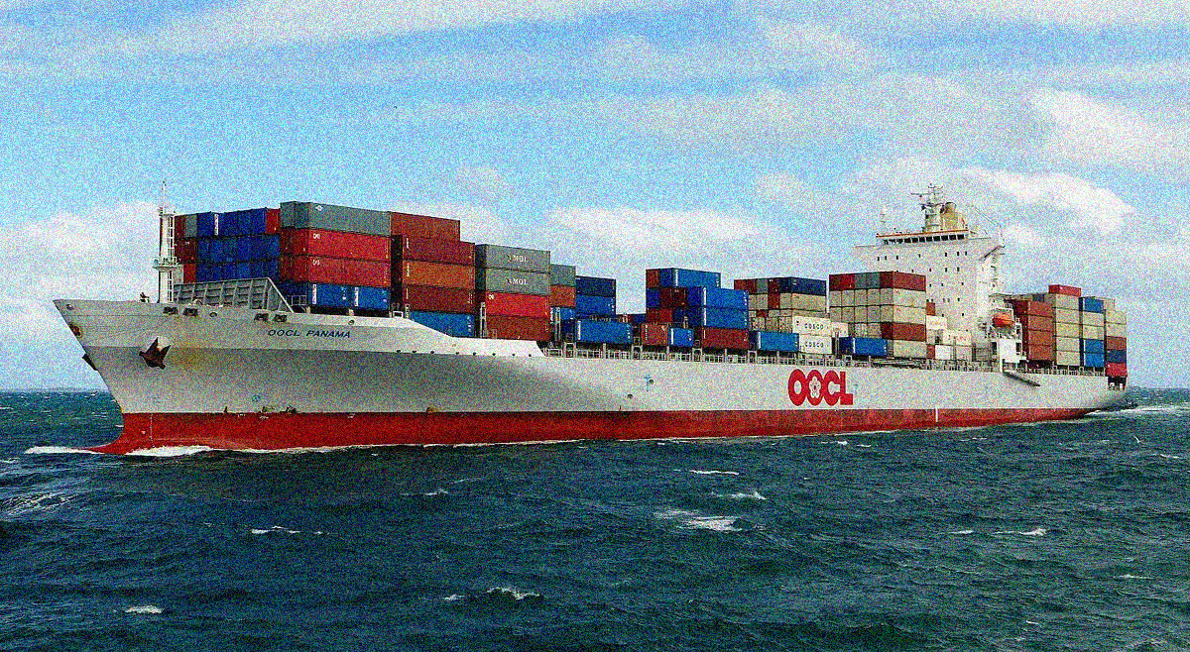
Applying Queuing Theory in Port Handling System
A PROJECT By:
Aanchal Dusija A009
Raj Shah A025
Shiven Khosla A035

Slide 2

Agenda
Introduction to Queuing Theory
A brief on Jawaharlal Nehru Port Terminal
Objective of Study
Application of Queuing Theory in Ports
Data Collection
Data Analysis
Conclusion
Limitations
Future Scope
Bibliography

Slide 3
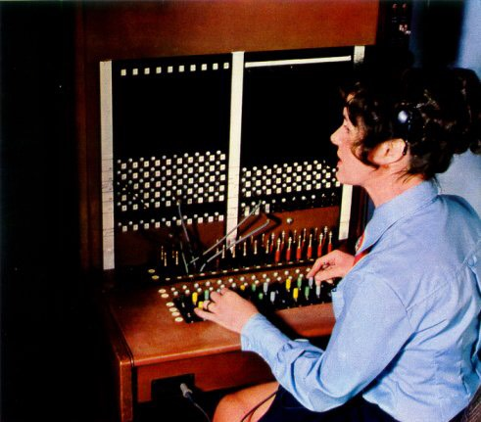

Introduction To Queuing Theory
Queuing theory is the mathematical study of the congestion and delays of waiting in line.
History & Development –
Queuing Theory owes its development to A. K. Erlang.
Waiting Line Problem –
Arises because of either too much demand or too less demand.
Applying Queuing Theory –
All situations involving customers like restaurants, cafeterias,
theatres, hospitals, etc.
Notes:
Aanchal

Slide 4


Understanding Queuing Theory
Notes:
Aanchal

Slide 5
Kendall’s Notation
The complete notation can be expressed as: (a/b/c) (d/e/f)
a = Arrival Distribution
b = Service Time Distibution
c = Number of service channels
d = Service Discipline
e = Maximum Number of Customers allowed in the system
f = Calling Population
Notes:
Aanchal

Slide 6
Jawaharlal Nehru Port Trust (JNPT)
Formerly known as Nhava Sheva Port.
The largest container port in India.
Initially, 2 terminals were constructed; the Bulk Terminal and the Container Terminal.
The port has diversified its activities for automobiles (export), liquid bulk, cement (coastal cargo) and few other commodities.
Equipped with one of the most modern cargo handling facilities, JNPT has been a pioneer in running its day-to-day operations.
Notes:
Shiven

Slide 7
Highlights Of JNPT
Land Area is 3000+ hectares.
Jawaharlal Nehru Port is International Ship and Port Facility Security (ISPS) compliant since 2004.
Handles about 56% of total containers handled by all major ports in India.
Connected with 34 Container Freight Stations (CFSs) and 46 Inland Container Depot (ICDs) destinations.
Poised to handle 10 million TEUs of containers by the year 2022 – 23.
Notes:
Shiven

Slide 8
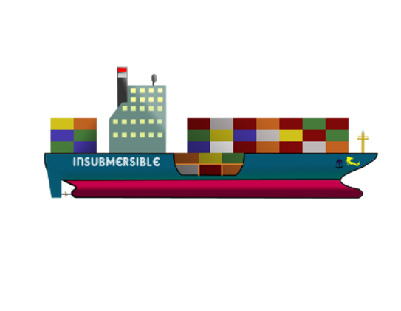



JNPT
Container Terminal
Bulk Terminal
JNPCT
NSIGT
NSICT
APMT
BMCT
JNPBT
Notes:
Shiven

Slide 9
Objective of Study
To study the pattern of ships arriving at JNPT and check if they follow Poisson Distribution.
To examine the waiting time of the ships and check if they follow Exponential Distribution.
To study the existing handling services pattern provided by JNP Authority.
Try to optimize the waiting time and service time.
Suggest alternate possible courses of action.
Notes:
Shiven

Slide 10
Collection of Data
From the official website of JNPT, the data was collected.
The data was collected for a span of 6 weeks.
Analysing the data of JNPCT (i.e. Jawaharlal Nehru Container Terminal).
After which the Arrival and Service Time Distribution was checked for Poisson and Exponential Distribution respectively.

Slide 11
Functioning of JNPCT
Servers – There are 2 docks namely CB01 & CB02.
Customers – Ships which are being served and waiting in the queue to be served.
System – The loading and/or unloading of containerised cargo in the ships and using the facilities of the port.

Slide 12
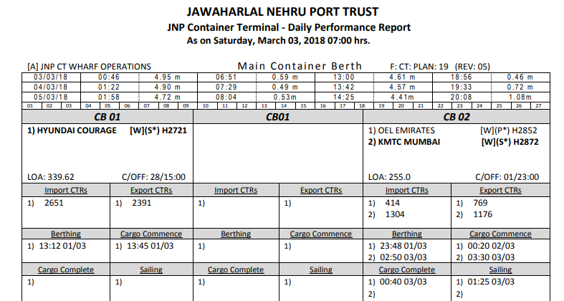

Slide 13
Explaining our model
Assuming the berthing time to be the arrival time.
While data collection, many inconsistent data points were found.
In order to solve the problem, different statistical methods were applied to fill the missing entries.
JNPT Datasheet

Slide 14
Queuing Theory at Alexandria Port
Checking if the Arrival of the ships follow Poisson Distribution.
Checking if the Service Time of container handling follows Erlang Distribution.
Analysing the current system of Alexandria Port.

Slide 15
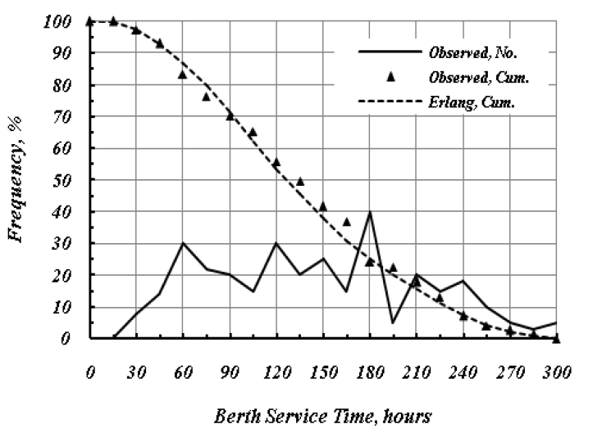
Explaining the Model for Alexandria Port
Alexandria Datasheet
Poisson Arrival Distribution
Erlang Service-time Distribution

Slide 16
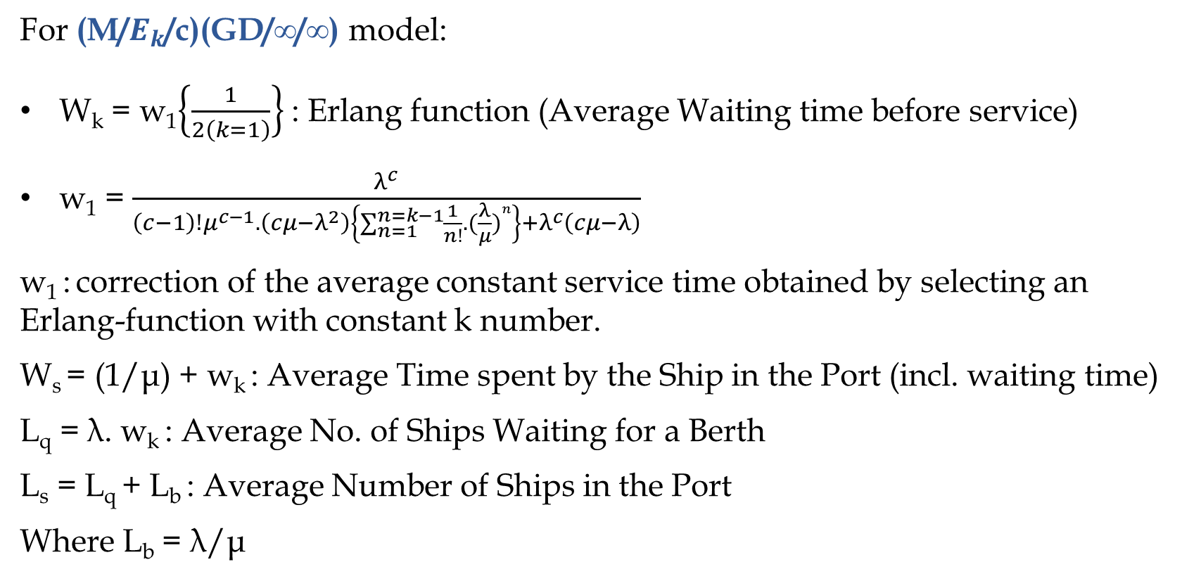
Steady State Measures Of Performance
For (M/$E_{k}$/c)(GD/∞/∞) model:
W_{k} = w₁$\left\{\frac{1}{2\left(k=1\right)}\right\}$ : Erlang function (Average Waiting time before service)
w₁ = $\frac{λ^{c}}{\left(c−1\right)!μ^{c−1}.\left(cμ−λ^{2}\right)\left\{\sum_{n=1}^{n=k−1}{\frac{1}{n!}.({\frac{λ}{μ})}^{n}}\right\}+λ^{c}\left(cμ−λ\right)}$
w₁ : correction of the average constant service time obtained by selecting an Erlang-function with constant k number.
W_{s} = (1/μ) + w_{k} : Average Time spent by the Ship in the Port (incl. waiting time)
L_{q} = λ. w_{k} : Average No. of Ships Waiting for a Berth
L_{s} = L_{q} + L_{b} : Average Number of Ships in the Port
Where L_{b} = λ/μ

Slide 17
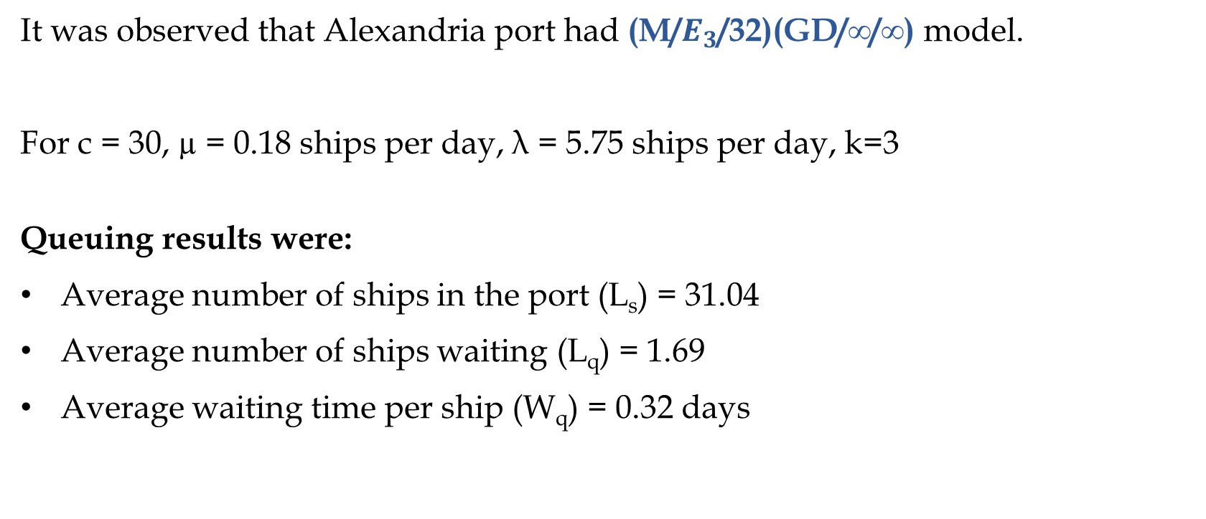
Model of the Alexandria Port
It was observed that Alexandria port had (M/$E_{3}$/32)(GD/∞/∞) model.
For c = 30, µ = 0.18 ships per day, λ = 5.75 ships per day, k=3
Queuing results were:
Average number of ships in the port (L_{s}) = 31.04
Average number of ships waiting (L_{q}) = 1.69
Average waiting time per ship (W_{q}) = 0.32 days

Slide 18
Conclusion
Since, the model turned out to be deterministic, it was realised that statistical methods had already been applied to the port data and JNPT had been optimized.
Yet, the port had been facing congession issues since the past few years. In order to solve the problem, a new project called “Sagarmala” was taken up by the Government of India to modernize the port facilities, enhance connectivity, industrialisation, etc.
Additionaly, a new terminal called Bharat Mumbai Container Terminal was recently opened on February 18th, 2018. BMCT increases the port capacity by 4.8 million TEUs.

Slide 19
Limitations
Unavailability of Actual Arrival Time of ships on the official website of JNPT.
Unavailability of information on Ship Diversion from JNPT to other ports.
Missing data entry because of Daily Reports not getting published on Sundays.
Unavailability of information on other parameters affecting Port operations in case of JNPT.
Lack of Service time data in the Research Paper of Alexandria Port.

Slide 20
Future Scope
Optimizing the Ship Servicing by striking a balance between costs and time.
Applying Queuing theory for yard and gate operations as well as for containers.

Slide 21
References
For Information on JNPT:
http://www.jnport.gov.in/highlights.aspx
http://www.jnport.gov.in/port_details.aspx
http://www.jnport.gov.in/JNPCT.aspx
http://www.jnport.gov.in/NSICT.aspx
http://www.jnport.gov.in/GTI.aspx
For JPNT Data:
http://jnport.gov.in/vessel.aspx
For Research Paper:
Application of queuing theory to the container terminal at Alexandria seaport
By - M. E. El-Naggar
Journal of Soil Science and Environmental Management Vol. 1 (4), pp. 77-85, June 2010
Available online at http://www.academicjournals.org/JSSEM

Slide 22
ThanQueue
Notes:
Raj

